Slide 1
FirstCall Agent
Microsoft FDE Program

Slide 2
Ortho
The current process is that Customer Service and Sales Representative’s have to find all documentation related to Training, Orders, Pricing, Account, Surgery/Surgical case, Product information, etc. by spending a lot of time searching through various sources/systems, making phone calls or sending emails/texts. Currently it is very labor intensive and time consuming to find this information.
Sales Rep submit usage (for order)
CSR processes orders
Hospital sends PO and Order can be closed
Surgery takes place
90% of the phone calls, emails, or texts between CSRs and Sales Reps, are for Training, Orders, Pricing, Account, Surgery/Surgical case information, Product etc. related to the process above.
 | Sales Reps | CSR
Joint Replacement | 1,605 | 225
Trauma & Extremities | 1,766 | 218

Slide 3
FirstCall Agent
This FirstCall Agent is designed to provide accurate, timely answers to Sales Reps and Customer Service teams. By integrating with key systems and leveraging the existing access controls, the agent provides the most up-to-date and reliable data to ensure CSRs and Sales Reps always have the most current information at their fingertips to avoid errors and inefficiencies.
Benefits
Allow existing CS headcount to focus on more complex, business critical activities for JR & TE to continue to grow.
Drive operational efficiencies.
Mitigate inefficiencies introduced by SAP.
Sets foundation for the next iteration of AI Agent use cases.
Across Ortho, this translates to annual savings of ~14k hours for CSRs (~10 minutes/day/CSR) and ~42k hours for Sales Rep (~3 minutes/day/Rep)
What it is
For Sales Reps, the agent can handle inquiries that would typically go to CSRs, including:
Order details
Account information
Surgery and surgical case details
Pricing
Highspot materials
Educational Content
For CSRs, the agent can answer questions related to:
SAP knowledge
Onboarding and Training
Order details
Account information

Slide 4
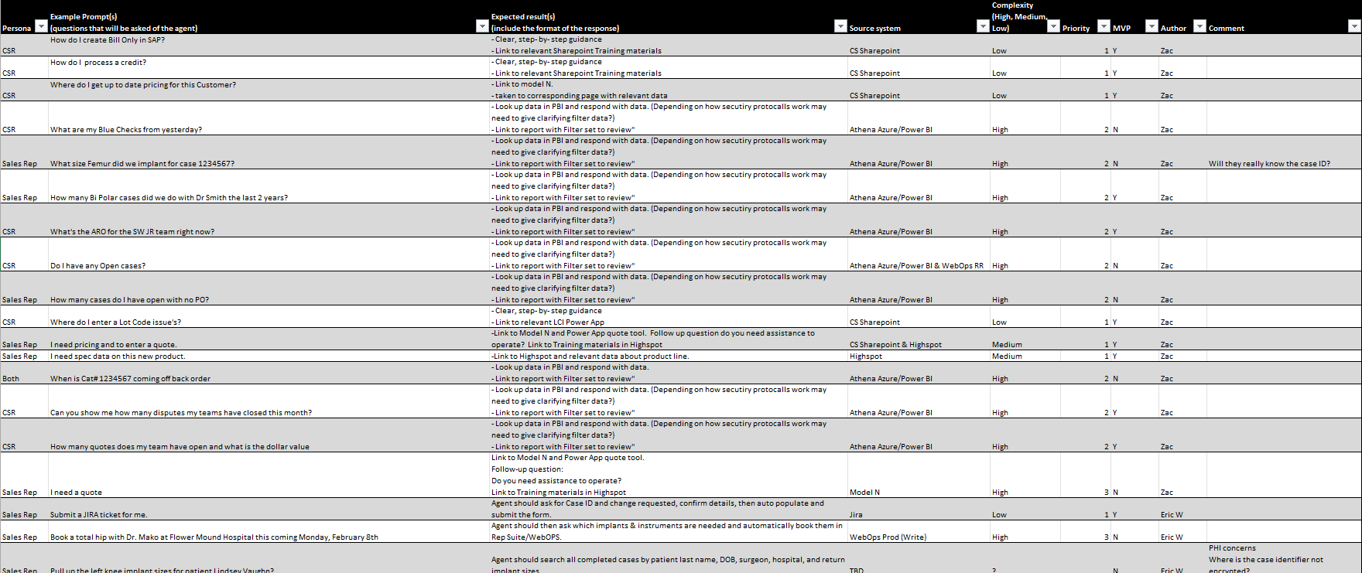
Sample Prompts
FirstCall_Prompts.xlsx

Slide 5
Data Sources
 | CSR | Sales Rep
Training | SharePoint | SharePoint & Highspot
Orders, Account | Athena (Azure data lake), Power BI | Athena (Azure data lake), Power BI
Surgical Case | WebOps Read Replica | WebOps Read Replica
Pricing | Model N | Model N
Territory | Varicent/ Green Box & Athena | Varicent/ Green Box & Athena
Agentic |  | Jira (support tickets) & Formstack (Registration form)
*Inherit each integrated system access controls.

